Slide 1
Town or Country?
An investigation into Life Expectancy

Slide 2
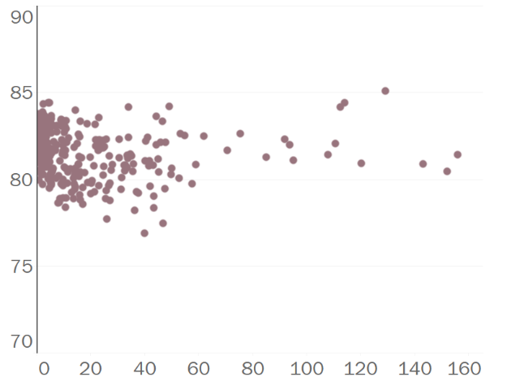
Does where you live affect life expectancy?
Is life expectancy highest in rural areas which have low density of population? Or does a wider range of characteristics need to be taken into account to give a more helpful idea of whether where you live affects your life expectancy?
There is little direct relationship between density and life expectancy
The Office for National Statistics has grouped Local Authorities into clusters
Life expectancy
Each dot represents a different Local Authority
The ONS has created eight clusters on the basis of a wide variety of traits taken from the 2011 census, including geography, employment type, affluence and ethnicity, and assigned each Local Authority to one of the clusters*
Population per hectare
* See appendix for full description of clusters

Slide 3
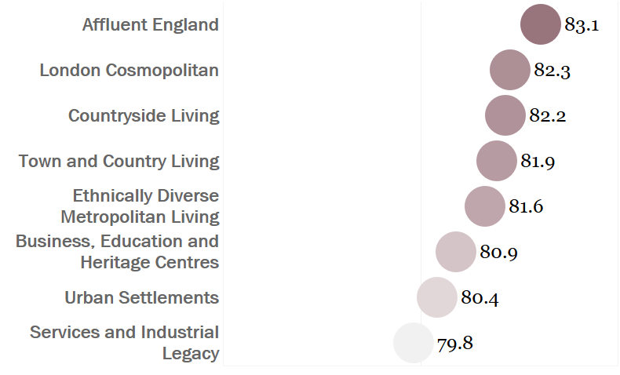
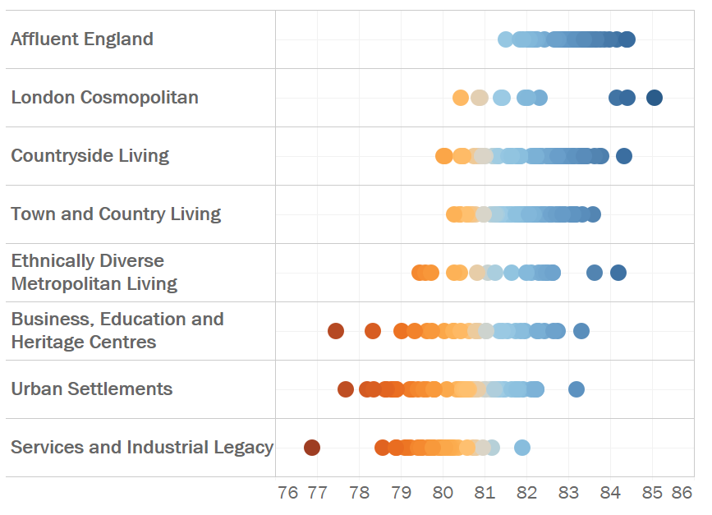
Clusters are useful but do not tell the whole story
Average life expectancy does vary across the eight different ONS clusters, suggesting that which cluster you live in, is important. But there is a lot of variance within clusters so there must be other factors which are also significant.
Average life expectancy varies across the different clusters
But life expectancy also varies within clusters
Each dot represents a different Local Authority
Life Expectancy
Life Expectancy

Slide 4
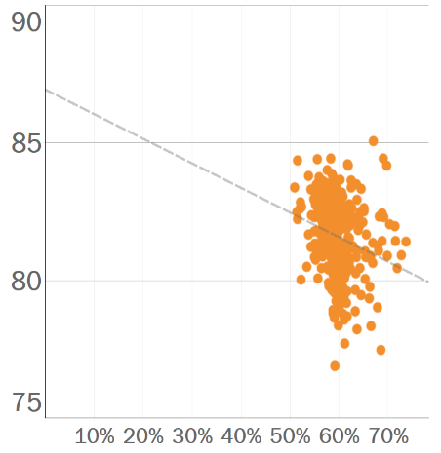
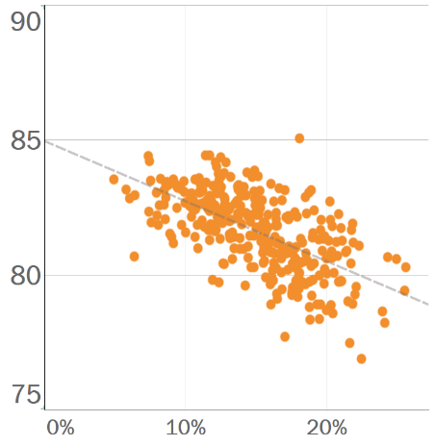
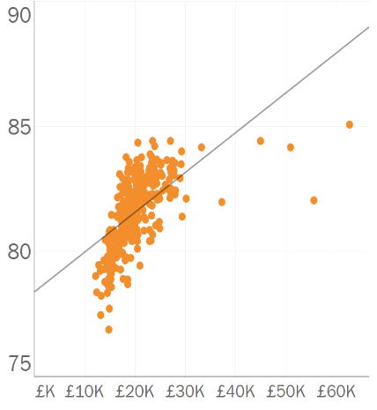
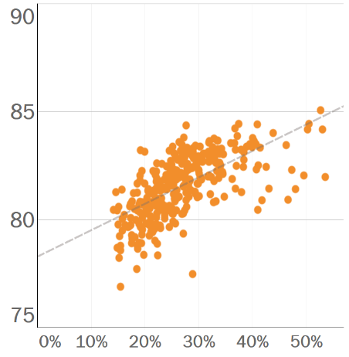
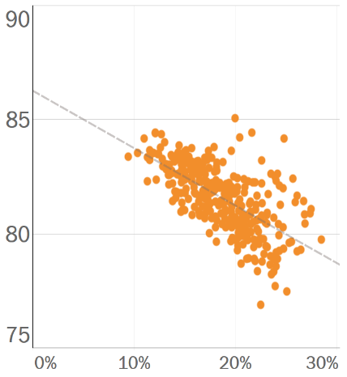
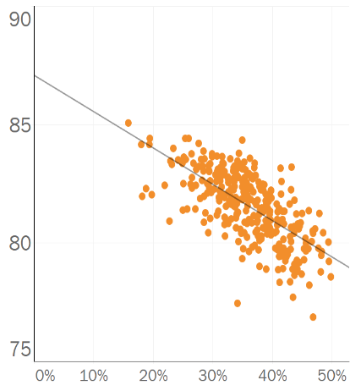
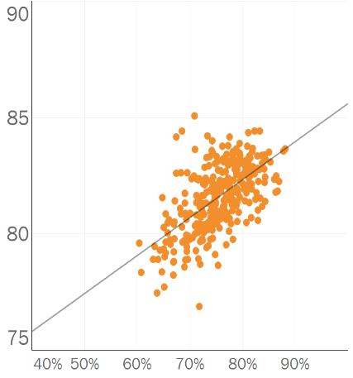
Underlying demographic and health indicators are important
The differences between average life expectancy in Local Authorities are partly explained by differences in the underlying population in each area. The relationship between life expectancy and different factors was explored by plotting life expectancy in each Local Authority against each factor:
Smoking
Graduates
Income
Working Age
Childhood Obesity
Low Qualifications
Employment Rate
The percentage of the population which is of working age (18-65)
The percentage of smokers in each Local Authority
The percentage of graduates in each Local Authority
Average household income
The percentage of children aged 10-11 who are obese
The percentage of people who do not have 5 A-C GCSEs
The percentage of people aged 18-65 who are employed
These five factors were the most important in determining
Life expectancy in Local Authorities
Life expectancy

Slide 5
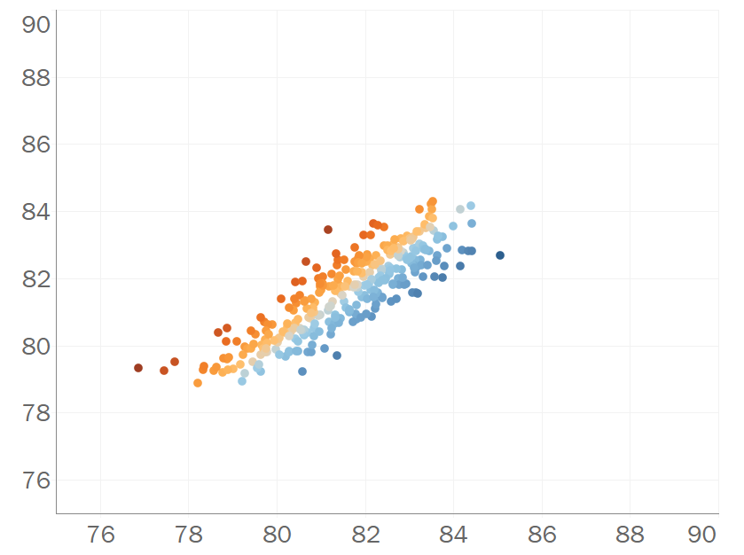
These factors explain >70% of the life expectancy differences
A model was built using the five demographic and health indicators. The model predicts life expectancy in each Local Authority based on the make up of the population in each area and closely mirrors actual life expectancy.
Predicted Life Expectancy plotted against Actual Life Expectancy
With an R² value of 0.73*, the model explains 73% of the variance in life expectancies between Local Authorities.
Factors in the model
Local Authorities with a lower than predicted life expectancy
Income
Low Qualifications
The model works well, but if it predicted life expectancy with complete accuracy then all the Local Authorities would fall along a single line and the R² value would be 1.
Smoking
Predicted Life Expectancy
Employment rate
Local Authorities with a higher than predicted life expectancy
Childhood obesity
* See appendix for explanation of R²
Actual Life Expectancy

Slide 6
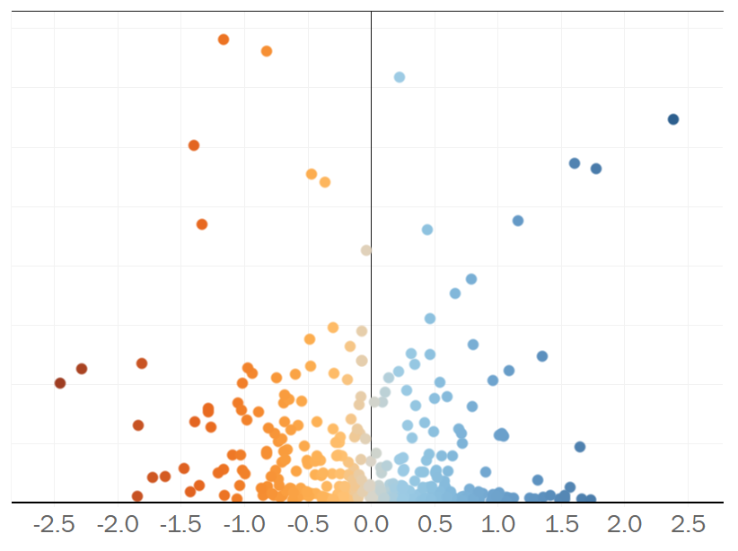
Population density does not explain the remaining differences
Can differences in population density explain the rest of the differences in life expectancy between Local Authorities which are not already explained by demographic and health indicators?
There is little relationship between density and difference to predicted life expectancy
If population density was an important factor in determining life expectancy then we would expect to see more of a pattern:
e.g. if living in a rural area had a positive effect on life expectancy then Local Authorities with low density would all have higher than predicted life expectancy
Density
Local Authorities with a lower than predicted life expectancy
Local Authorities with a higher than predicted life expectancy
Difference to predicted life expectancy

Slide 7
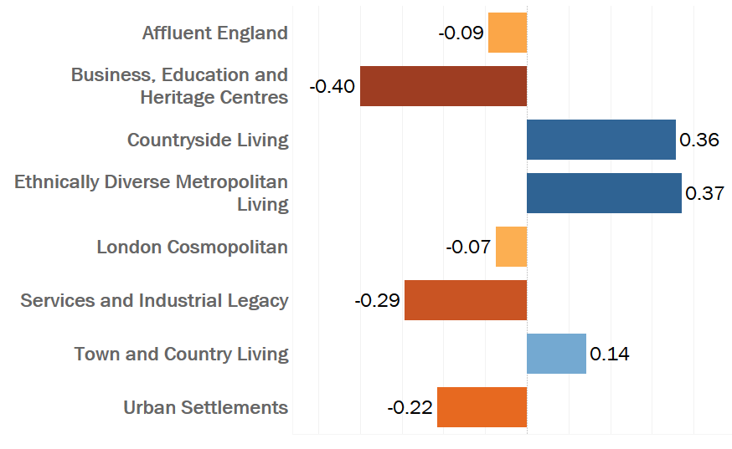
The most rural areas and some urban areas have high life expectancy
Looking at the average difference between predicted and actual life expectancy across clusters, there are significant variations between them. This suggests that the cluster you live in could have an effect on your life expectancy, even taking into account the make up of the local population.
There was considerable variation between clusters
Countryside Living (the most rural cluster) and Ethnically Diverse Metropolitan Living (one of the most urban and densely populated clusters) had the most positive outcomes.
So density of population and rural/urban environment do not by themselves seem to be decisive factors in determining life expectancy.
These clusters had the highest life expectancy versus the predicted value
Average difference to predicted life expectancy

Slide 8
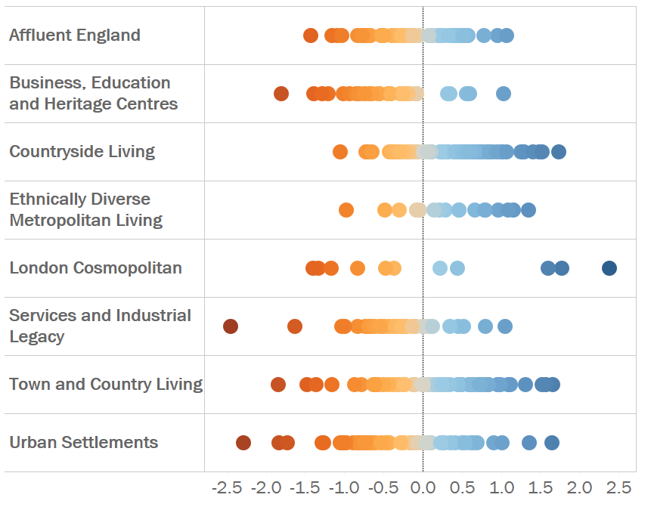
There are still some unexplained differences between Local Authorities
There was considerable variation between life expectancy within clusters. Some Local Authorities within the same cluster had much higher than predicted life expectancy whilst others had much lower numbers. There must be further factors or individual circumstances within Local Authorities driving these variances
There is still variation within clusters
The London Cosmopolitan cluster in particular has a very wide range of life expectancy differences

Slide 9
Conclusions
Demographics and Health indicators are important
The make up of the population in each Local Authority explains most of the differences in life expectancy.
The cluster you live in also matters
There is a significant difference between clusters, but the most positive groups are very different from each other. Clearly other factors are at work.
Further investigation needed
Within some clusters there is a wide variance of outcomes. Further investigation into individual Local Authorities is needed to find out what drives these variations.

Slide 10
Christabel Cooper
christabel @sensibleanalytics.co.uk
To see the full dataset and the Tableau workbooks behind this presentation, please visit:

Slide 11
Appendix
Descriptions of the clusters
Statistical techniques used

Slide 12
Descriptions of Clusters
These subgroups have been produced by the Office of National Statistics based on Census Data
Affluent England
10.3% of UK population, population density 3.7, median age 41 years The population of this supergroup typically live largely in counties in England near to and around London – Buckinghamshire, Hampshire, Hertfordshire, Kent, Oxfordshire and Surrey.
Residents are much more likely to live in detached housing and to own their own property. The supergroup has an above average ethnic mix and below average number of UK and Irish born residents. Residents are far more likely to be represented in the 5 to 14 years age group than nationally. Rates of divorce or separation are lower than nationally and the proportion of persons aged 16 years and over with higher qualifications is above the national average.
Unemployment rates are noticeably below the national average and for employed residents, they are more likely to work in the information and communication industries than nationally, more likely to work full-time, and are more likely to travel to work using public transport, though households owning two or more cars are also more prevalent than nationally.
Business, education and heritage centres
35 local authorities – 14.4% of UK population, population density 17.4, median age 35 years
The population of this supergroup live within larger cities throughout the UK, with either country and/or regional importance. Residents are more likely to live in either flats or terraces and to privately rent their home. The supergroup has an above average ethnic mix, with an above average proportion of residents born in other EU countries. A result of this is that households are less likely to speak English or Welsh as their main language.
Those in employment are more likely to be working in the accommodation or food service activities and education sector and to use public transport to travel to work. Compared with the UK, educational qualifications are higher, though unemployment is marginally higher.

Slide 13
Descriptions of Clusters
These subgroups have been produced by the Office of National Statistics based on Census Data
Countryside Living
83 local authorities – 15.2% of UK population, population density 0.7, median age 46 years
The population for this supergroup are characterised by living in rural areas with a low population density and a much higher median age (46 years) compared with the UK as a whole (39 years).
Residents are more likely to own their own home and to live in a detached property. Unemployment and qualification levels are both below the national average. Households are more likely to own two or more vehicles and to use private transport to travel to work. Part-time working is also more prevalent than generally in the UK.
Workers are far more likely to be employed in the agriculture, forestry and fishing industry, and the accommodation or food service activities industries than workers in the UK generally.
Ethnically diverse metropolitan living
19 local authorities – 9.4% of UK population, population density 46.5, median age 33 years
The population of this supergroup tend to be live in Inner and Outer London Boroughs. Areas outside London covered by this supergroup include Birmingham, Leicester, Luton and Slough.
The major characteristic of these areas is that they have a high proportion of residents from non-White ethnic groups. Population density is high, as is overcrowding (households who have on average fewer or less rooms than required) and there is a relatively young population age structure. Households are more likely to reside in terrace housing or flats, either socially-rented or privately-rented, than households generally. Unemployment is higher than recorded nationally. Compared with the UK as a whole, workers in the administrative or support services industry are most over-represented and workers are more likely to use public transport to get to work.

Slide 14
Descriptions of Clusters
These subgroups have been produced by the Office of National Statistics based on Census Data
London Cosmopolitan
12 local authorities – 4.2% of UK population, population density 106.8, median age 32 years
The population of this group is located within 12 Inner London boroughs. The areas of London covered by this supergroup are characterised by a very high population density and a relatively low median age (32 years).
All non-White ethnic groups have a higher representation than the UK as a whole, especially people of Black or Arab ethnicity, with an above average proportion of residents born in other EU countries. Residents are more likely to live in flats and are more likely to rent. A higher proportion of people use public transport to get to work, with lower car ownership and higher unemployment. Those in employment are more likely to work in the information and communication, and the financial, insurance or real estate industries.
Services and industrial legacy
57 local authorities – 15.3% of UK population, population density 4.7, median age 41 years
The population of this group is predominately in the Central Belt in Scotland, northern England and south Wales – all traditional mining areas.
There is a much lower representation of ethnic minority groups than for the UK as a whole and a higher than average proportion of residents born in the UK and Ireland. Rates of divorce and separation are above the national rate. Households are more likely to have children and are more likely to live in semi-detached or terraced properties and to socially rent.
There is a smaller proportion of people with higher-level qualifications, with rates of unemployment above the national level. Those in employment are more likely to be employed in the energy, water or air conditioning industries, manufacturing industries, and the mining, quarrying or construction industries. Workers are more likely to use private transport to travel to work than nationally.

Slide 15
Descriptions of Clusters
These subgroups have been produced by the Office of National Statistics based on Census Data
Town and Country living
79 local authorities – 16.1% of UK population, population density 2.0, median age 42 years
This supergroup is represented within all countries of the UK and English regions with the exception of the North East and London regions. The population density (at 2.0 persons per hectare) is below the UK as a whole (at 2.6 persons per hectare).
There is a low proportion of persons by minority ethnic group and a relatively high proportion of residents were born in the UK or Ireland. Compared with the UK as a whole, the population is more likely to be aged 45 years and over, and with a higher median age (42 years).
Residents are more likely to live in detached or semi-detached properties, to own their home and to use private transport for travel to work, with higher car ownership. Residents also have higher levels of educational attainment. People are more likely to work in manufacturing industries.
Urban settlements
55 local authorities – 15.0% of UK population, population density 12.6, median age 38 years
The population of this supergroup are confined to the nine English regions and Wales (Newport) only. The areas are characterised by a slightly younger age structure than nationally, with higher proportions of all groups aged 45 and under (covering the age groups 0 to 4 years, 5 to 14 years and 25 to 44 years).
Ethnic groups are over-represented compared with the national picture and households are more likely to live in semi-detached or terraced housing. Adults generally have lower qualifications than nationally and are more likely to be unemployed. Residents who are employed are more likely to work in the wholesale and retail trade, transport and storage, and administrative and support services industries. Workers are more likely to commute using public transport and car ownership is lower than nationally.

Slide 16
Statistical analysis – R squared values
Multiple linear regression was used to build the model used in the presentation. It used five factors:
Predicted Life Expectancy =
82.015 +
Income Percentile *1.80 +
Low Qualification % * -3.59 +
% of Smokers * -7.74 +
Employment Rate % *3.66 +
% Childhood Obesity * -8.81
R squared is a measure of how closely the values predicted by a linear model match the observed values (in this case - the actual life expectancies for each Local Authority). It is the percentage of the variation in the observed values that can be explained by the model. R-squared is always between 0 and 100%:
0% indicates that the model explains none of the variability of the observed data around its mean.
100% indicates that the model explains all the variability of the observed data around its mean.
In general, the higher the R-squared, the better the model fits your data. This model had an R-squared value of 0.73, meaning that 73% of the differences in life expectancy between Local Authorities can be explained by the model.

